Slide 1
CS162 Operating Systems and Systems Programming Lecture 9 Synchronization, Readers/Writers example, Scheduling
February 22nd, 2016
Prof. Anthony D. Joseph
http://cs162.eecs.Berkeley.edu

Slide 2
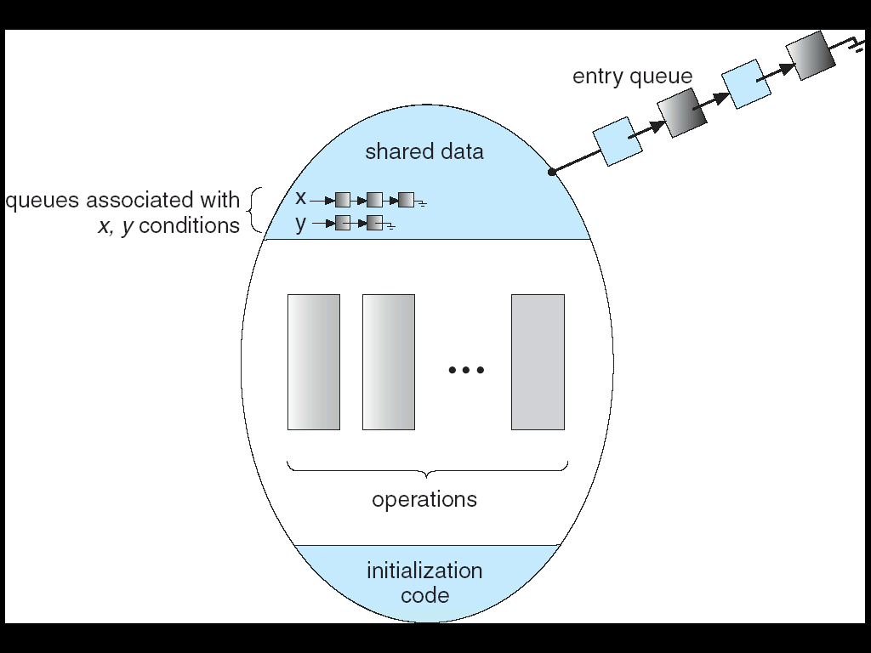
Review: Monitor with Condition Variables
Lock: the lock provides mutual exclusion to shared data
Always acquire before accessing shared data structure
Always release after finishing with shared data
Lock initially free
Condition Variable: a queue of threads waiting for something inside a critical section
Key idea: make it possible to go to sleep inside critical section by atomically releasing lock at time we go to sleep
Contrast to semaphores: Can’t wait inside critical section

Slide 3
Review: Condition Variables
How do we change the RemoveFromQueue() routine to wait until something is on the queue?
Could do this by keeping a count of the number of things on the queue (with semaphores), but error prone
Condition Variable: a queue of threads waiting for something inside a critical section
Key idea: allow sleeping inside critical section by atomically releasing lock at time we go to sleep
Contrast to semaphores: Can’t wait inside critical section
Operations:
Wait(&lock): Atomically release lock and go to sleep. Re-acquire lock later, before returning.
Signal(): Wake up one waiter, if any
Broadcast(): Wake up all waiters
Rule: Must hold lock when doing condition variable ops!
In Birrell paper, he says can perform signal() outside of lock – IGNORE HIM (this is only an optimization)

Slide 4
Review: Mesa vs. Hoare Monitors
Need to be careful about precise definition of signal and wait. Consider a piece of our dequeue code:
while (queue.isEmpty()) { dataready.wait(&lock); // If nothing, sleep } item = queue.dequeue(); // Get next item
Why didn’t we do this?
if (queue.isEmpty()) { dataready.wait(&lock); // If nothing, sleep } item = queue.dequeue(); // Get next item
Answer: depends on the type of scheduling
Hoare-style (most textbooks):
Signaler gives lock, CPU to waiter; waiter runs immediately
Waiter gives up lock, processor back to signaler when it exits critical section or if it waits again
Mesa-style (most real operating systems):
Signaler keeps lock and processor
Waiter placed on ready queue with no special priority
Practically, need to check condition again after wait

Slide 5
Extended Example: Readers/Writers Problem
W
R
R
R
Motivation: Consider a shared database
Two classes of users:
Readers – never modify database
Writers – read and modify database
Is using a single lock on the whole database sufficient?
Like to have many readers at the same time
Only one writer at a time

Slide 6
Basic Readers/Writers Solution
Correctness Constraints:
Readers can access database when no writers
Writers can access database when no readers or writers
Only one thread manipulates state variables at a time
Basic structure of a solution:
Reader() Wait until no writers Access data base Check out – wake up a waiting writer
Writer() Wait until no active readers or writers Access database Check out – wake up waiting readers or writer
State variables (Protected by a lock called “lock”):
int AR: Number of active readers; initially = 0
int WR: Number of waiting readers; initially = 0
int AW: Number of active writers; initially = 0
int WW: Number of waiting writers; initially = 0
Condition okToRead = NIL
Conditioin okToWrite = NIL

Slide 7
Code for a Reader
Reader() { // First check self into system lock.Acquire();
while ((AW + WW) > 0) { // Is it safe to read? WR++; // No. Writers exist okToRead.wait(&lock); // Sleep on cond var WR--; // No longer waiting }
AR++; // Now we are active! lock.release();
// Perform actual read-only access AccessDatabase(ReadOnly);
// Now, check out of system lock.Acquire(); AR--; // No longer active if (AR == 0 && WW > 0) // No other active readers okToWrite.signal(); // Wake up one writer lock.Release(); }
Why Release the Lock here?

Slide 8
Code for a Writer
Writer() { // First check self into system lock.Acquire();
while ((AW + AR) > 0) { // Is it safe to write? WW++; // No. Active users exist okToWrite.wait(&lock); // Sleep on cond var WW--; // No longer waiting }
AW++; // Now we are active! lock.release();
// Perform actual read/write access AccessDatabase(ReadWrite);
// Now, check out of system lock.Acquire(); AW--; // No longer active if (WW > 0){ // Give priority to writers okToWrite.signal(); // Wake up one writer } else if (WR > 0) { // Otherwise, wake reader okToRead.broadcast(); // Wake all readers } lock.Release(); }
Why Give priority to writers?
Why broadcast() here instead of signal()?

Slide 9
Simulation of Readers/Writers solution
Consider the following sequence of operators:
R1, R2, W1, R3
On entry, each reader checks the following:
while ((AW + WW) > 0) { // Is it safe to read? WR++; // No. Writers exist okToRead.wait(&lock); // Sleep on cond var WR--; // No longer waiting }
AR++; // Now we are active!
First, R1 comes along: AR = 1, WR = 0, AW = 0, WW = 0
Next, R2 comes along: AR = 2, WR = 0, AW = 0, WW = 0
Now, readers make take a while to access database
Situation: Locks released
Only AR is non-zero

Slide 10
Simulation(2)
Next, W1 comes along: while ((AW + AR) > 0) { // Is it safe to write? WW++; // No. Active users exist okToWrite.wait(&lock); // Sleep on cond var WW--; // No longer waiting }
AW++;
Can’t start because of readers, so go to sleep:
AR = 2, WR = 0, AW = 0, WW = 1
Finally, R3 comes along: AR = 2, WR = 1, AW = 0, WW = 1
Now, say that R2 finishes before R1: AR = 1, WR = 1, AW = 0, WW = 1
Finally, last of first two readers (R1) finishes and wakes up writer:
if (AR == 0 && WW > 0) // No other active readers okToWrite.signal(); // Wake up one writer

Slide 11
Simulation(3)
When writer wakes up, get: AR = 0, WR = 1, AW = 1, WW = 0
Then, when writer finishes:
if (WW > 0){ // Give priority to writers okToWrite.signal(); // Wake up one writer } else if (WR > 0) { // Otherwise, wake reader okToRead.broadcast(); // Wake all readers }
Writer wakes up reader, so get:
AR = 1, WR = 0, AW = 0, WW = 0
When reader completes, we are finished

Slide 12
Questions
Can readers starve? Consider Reader() entry code:
while ((AW + WW) > 0) { // Is it safe to read? WR++; // No. Writers exist okToRead.wait(&lock); // Sleep on cond var WR--; // No longer waiting }
AR++; // Now we are active!
What if we erase the condition check in Reader exit?
AR--; // No longer active if (AR == 0 && WW > 0) // No other active readers okToWrite.signal(); // Wake up one writer
Further, what if we turn the signal() into broadcast()
AR--; // No longer active okToWrite.broadcast(); // Wake up one writer
Finally, what if we use only one condition variable (call it “okToContinue”) instead of two separate ones?
Both readers and writers sleep on this variable
Must use broadcast() instead of signal()

Slide 13
Administrivia
Midterm coming up soon
Wednesday 3/9 6-7:30PM
10 EVANS (Seats: 237); 155 DWINELLE (Seats: 481)
We will assign you to a room
Closed book, no calculators, one double-side page of handwritten notes
No class that day, extra office hours
Topics will include the material through lecture 12 (Wed 3/2)
Includes lectures, project 1, homeworks, readings, textbook

Slide 14
BREAK

Slide 15
Can we Construct Monitors from Semaphores?
Locking aspect is easy: Just use a mutex
Can we implement condition variables this way?
Wait() { semaphore.P(); }
Signal() { semaphore.V(); }
Doesn’t work: Wait() may sleep with lock held
Does this work better?
Wait(Lock lock) { lock.Release(); semaphore.P(); lock.Acquire(); } Signal() { semaphore.V(); }
No: Condition vars have no history, semaphores have history:
What if thread signals and no one is waiting? NO-OP
What if thread later waits? Thread Waits
What if thread V’s and noone is waiting? Increment
What if thread later does P? Decrement and continue

Slide 16
Construction of Monitors from Semaphores (con’t)
Problem with previous try:
P and V are commutative – result is the same no matter what order they occur
Condition variables are NOT commutative
Does this fix the problem?
Wait(Lock lock) { lock.Release(); semaphore.P(); lock.Acquire(); } Signal() { if semaphore queue is not empty semaphore.V(); }
Not legal to look at contents of semaphore queue
There is a race condition – signaler can slip in after lock release and before waiter executes semaphore.P()
It is actually possible to do this correctly
Complex solution for Hoare scheduling in book
Can you come up with simpler Mesa-scheduled solution?

Slide 17
Monitor Conclusion
Monitors represent the logic of the program
Wait if necessary
Signal when change something so any waiting threads can proceed
Basic structure of monitor-based program:
lock while (need to wait) { condvar.wait(); } unlock do something so no need to wait lock
condvar.signal();
unlock
Check and/or update state variables
Wait if necessary
Check and/or update
state variables

Slide 18
C-Language Support for Synchronization
C language: Pretty straightforward synchronization
Just make sure you know all the code paths out of a critical section
int Rtn() { lock.acquire(); … if (exception) { lock.release(); return errReturnCode; } … lock.release(); return OK; }
Watch out for setjmp/longjmp!
Can cause a non-local jump out of procedure
In example, procedure E calls longjmp, poping stack back to procedure B
If Procedure C had lock.acquire, problem!
Proc A
Proc B
Calls setjmp
Stack growth
Proc C
lock.acquire
Proc D
Proc E
Calls longjmp

Slide 19
C++ Language Support for Synchronization
Languages with exceptions like C++
Languages that support exceptions are problematic (easy to make a non-local exit without releasing lock)
Consider:
void Rtn() { lock.acquire(); … DoFoo(); … lock.release(); } void DoFoo() { … if (exception) throw errException; … }
Notice that an exception in DoFoo() will exit without releasing the lock!

Slide 20
C++ Language Support for Synchronization (con’t)
Must catch all exceptions in critical sections
Catch exceptions, release lock, and re-throw exception: void Rtn() { lock.acquire(); try { … DoFoo(); … } catch (…) { // catch exception lock.release(); // release lock throw; // re-throw the exception } lock.release(); } void DoFoo() { … if (exception) throw errException; … }
Even Better: auto_ptr<T> facility. See C++ Spec.
Can deallocate/free lock regardless of exit method

Slide 21
Java Language Support for Synchronization
Java has explicit support for threads and thread synchronization
Bank Account example: class Account { private int balance; // object constructor public Account (int initialBalance) { balance = initialBalance; } public synchronized int getBalance() { return balance; } public synchronized void deposit(int amount) { balance += amount; } }
Every object has an associated lock which gets automatically acquired and released on entry and exit from a synchronized method

Slide 22
Java Language Support for Synchronization (con’t)
Java also has synchronized statements:
synchronized (object) { … }
Since every Java object has an associated lock, this type of statement acquires and releases the object’s lock on entry and exit of the body
Works properly even with exceptions:
synchronized (object) { … DoFoo(); … } void DoFoo() { throw errException; }

Slide 23
Java Language Support for Synchronization (con’t 2)
In addition to a lock, every object has a single condition variable associated with it
How to wait inside a synchronization method of block:
void wait(long timeout); // Wait for timeout
void wait(long timeout, int nanoseconds); //variant
void wait();
How to signal in a synchronized method or block:
void notify(); // wakes up oldest waiter
void notifyAll(); // like broadcast, wakes everyone
Condition variables can wait for a bounded length of time. This is useful for handling exception cases:
t1 = time.now(); while (!ATMRequest()) { wait (CHECKPERIOD); t2 = time.new(); if (t2 – t1 > LONG_TIME) checkMachine(); }
Not all Java VMs equivalent!
Different scheduling policies, not necessarily preemptive!

Slide 24
Recall: Better Implementation of Locks by Disabling Interrupts
Key idea: maintain a lock variable and impose mutual exclusion only during operations on that variable
Really only works in kernel – why?
int mylock = FREE;
Acquire(&mylock) – Wait until lock is free, then grab
Release(&mylock) – Unlock, waking up anyone waiting
Acquire(int *lock) { disable interrupts; if (*lock == BUSY) { put thread on wait queue; Go to sleep(); // Enable interrupts? } else { *lock = BUSY; } enable interrupts; }
Release(int *lock) { disable interrupts; if (anyone on wait queue) { take thread off wait queue Place on ready queue; } else { *lock = FREE; } enable interrupts; }

Slide 25
In-Kernel Lock: Simulation
Value: 0
waiters
owner
READY
Running
INIT
int value = 0;
Acquire() { disable interrupts; if (value == 1) {
put thread on wait-queue;
go to sleep() //?? } else { value = 1; }
enable interrupts; }
Thread A
Thread B
lock.Acquire();
…
critical section;
…
lock.Release();
lock.Acquire();
…
critical section;
…
lock.Release();
Release() { disable interrupts; if anyone on wait queue { take thread off wait-queue Place on ready queue; } else { value = 0; } enable interrupts; }

Slide 26
In-Kernel Lock: Simulation
Value: 1
waiters
owner
READY
Running
INIT
int value = 0;
Acquire() { disable interrupts; if (value == 1) {
put thread on wait-queue;
go to sleep() //?? } else { value = 1; }
enable interrupts; }
Thread A
Thread B
lock.Acquire();
…
critical section;
…
lock.Release();
lock.Acquire();
…
critical section;
…
lock.Release();
Release() { disable interrupts; if anyone on wait queue { take thread off wait-queue Place on ready queue; } else { value = 0; } enable interrupts; }

Slide 27
In-Kernel Lock: Simulation
Value: 1
waiters
owner
READY
Running
Running
INIT
int value = 0;
Acquire() { disable interrupts; if (value == 1) {
put thread on wait-queue;
go to sleep() //?? } else { value = 1; }
enable interrupts; }
Thread A
Thread B
lock.Acquire();
…
critical section;
…
lock.Release();
lock.Acquire();
…
critical section;
…
lock.Release();
Release() { disable interrupts; if anyone on wait queue { take thread off wait-queue Place on ready queue; } else { value = 0; } enable interrupts; }

Slide 28
In-Kernel Lock: Simulation
Value: 1
waiters
owner
READY
Running
Running
INIT
int value = 0;
Acquire() { disable interrupts; if (value == 1) {
put thread on wait-queue;
go to sleep() //?? } else { value = 1; }
enable interrupts; }
Thread A
Thread B
lock.Acquire();
…
critical section;
…
lock.Release();
lock.Acquire();
…
critical section;
…
lock.Release();
Release() { disable interrupts; if anyone on wait queue { take thread off wait-queue Place on ready queue; } else { value = 0; } enable interrupts; }

Slide 29
In-Kernel Lock: Simulation
Value: 1
waiters
owner
READY
Running
INIT
int value = 0;
Acquire() { disable interrupts; if (value == 1) {
put thread on wait-queue;
go to sleep() //?? } else { value = 1; }
enable interrupts; }
Thread A
Thread B
lock.Acquire();
…
critical section;
…
lock.Release();
lock.Acquire();
…
critical section;
…
lock.Release();
Release() { disable interrupts; if anyone on wait queue { take thread off wait-queue Place on ready queue; } else { value = 0; } enable interrupts; }

Slide 30
In-Kernel Lock: Simulation
Value: 1
waiters
owner
READY
Running
Running
INIT
int value = 0;
Acquire() { disable interrupts; if (value == 1) {
put thread on wait-queue;
go to sleep() //?? } else { value = 1; }
enable interrupts; }
Thread A
Thread B
lock.Acquire();
…
critical section;
…
lock.Release();
lock.Acquire();
…
critical section;
…
lock.Release();
Release() { disable interrupts; if anyone on wait queue { take thread off wait-queue Place on ready queue; } else { value = 0; } enable interrupts; }

Slide 31
Discussion
Notice that Scheduling here involves deciding who to take off the wait queue
Could do by priority, etc.
Same type of code works for in-kernel condition variables
The Wait queue becomes unique for each condition variable
Once again, transition to and from queues occurs with interrupts disabled

Slide 32
BREAK

Slide 33
Synchronization Summary
Semaphores: Like integers with restricted interface
Two operations:
P(): Wait if zero; decrement when becomes non-zero
V(): Increment and wake a sleeping task (if exists)
Can initialize value to any non-negative value
Use separate semaphore for each constraint
Monitors: A lock plus zero or more condition variables
Always acquire lock before accessing shared data
Use condition variables to wait inside critical section
Three Operations: Wait(), Signal(), Broadcast()

Slide 34
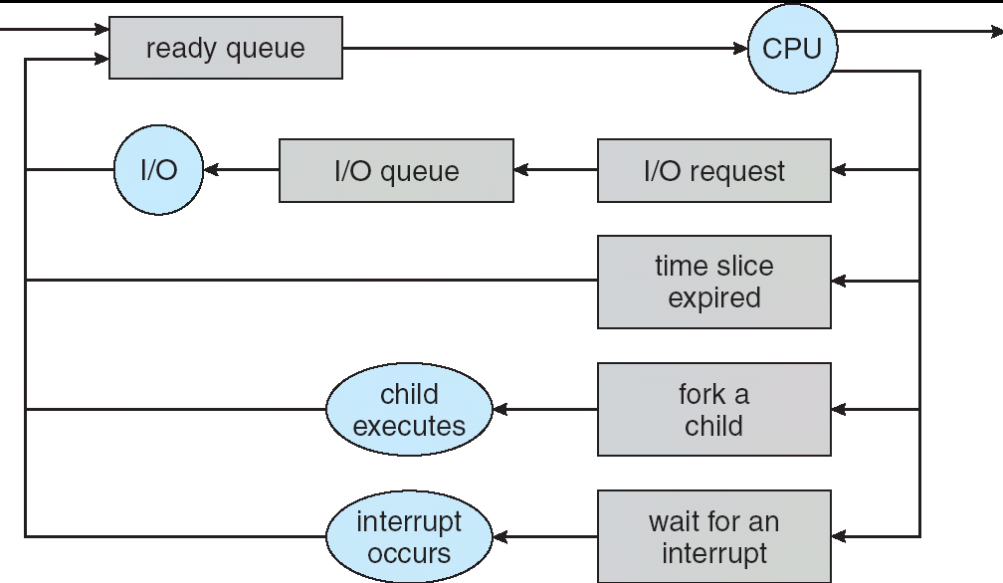
Recall: CPU Scheduling
Earlier, we talked about the life-cycle of a thread
Active threads work their way from Ready queue to Running to various waiting queues.
Question: How is the OS to decide which of several tasks to take off a queue?
Obvious queue to worry about is ready queue
Others can be scheduled as well, however
Scheduling: deciding which threads are given access to resources from moment to moment

Slide 35
Recall: Scheduling Assumptions
CPU scheduling big area of research in early 70’s
Many implicit assumptions for CPU scheduling:
One program per user
One thread per program
Programs are independent
Clearly, these are unrealistic but they simplify the problem so it can be solved
For instance: is “fair” about fairness among users or programs?
If I run one compilation job and you run five, you get five times as much CPU on many operating systems
The high-level goal: Dole out CPU time to optimize some desired parameters of system
USER1
USER2
USER3
USER1
USER2
Time

Slide 36
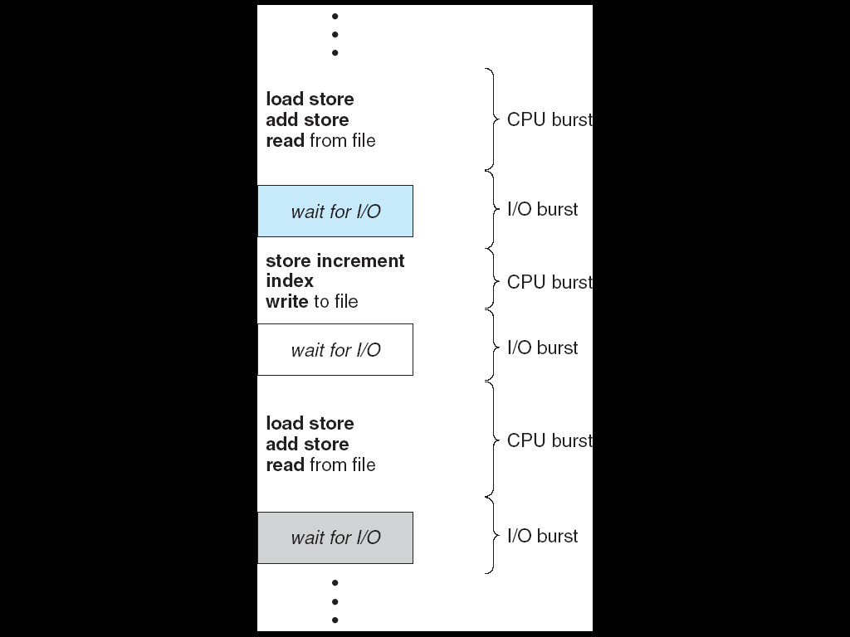
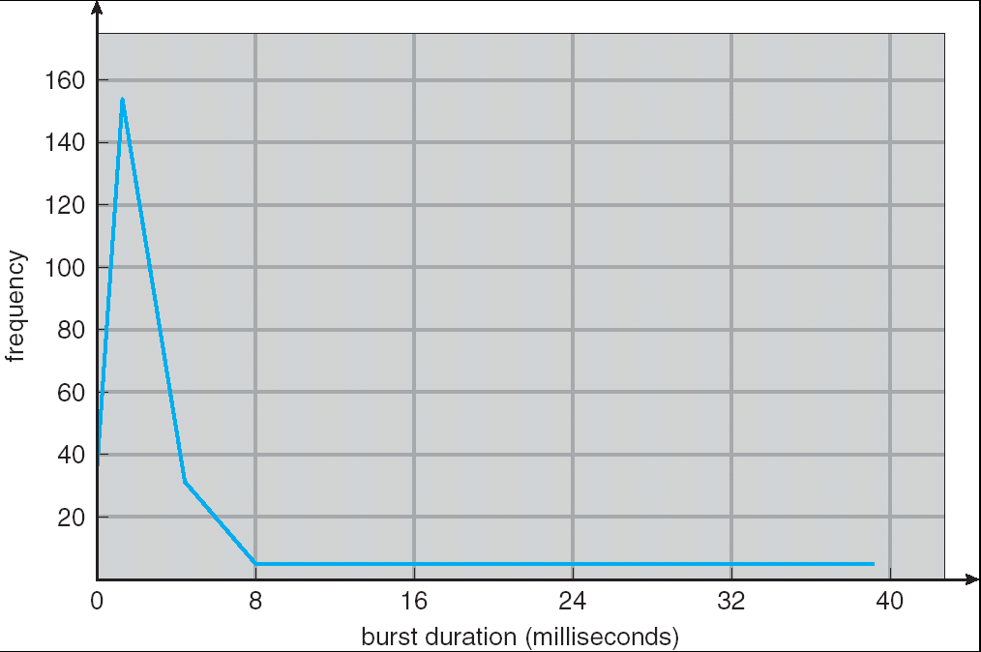
Recall: Assumption – CPU Bursts
Weighted toward small bursts
Execution model: programs alternate between bursts of CPU and I/O
Program typically uses the CPU for some period of time, then does I/O, then uses CPU again
Each scheduling decision is about which job to give to the CPU for use by its next CPU burst
With timeslicing, thread may be forced to give up CPU before finishing current CPU burst

Slide 37
Scheduling Policy Goals/Criteria
Minimize Response Time
Minimize elapsed time to do an operation (or job)
Response time is what the user sees:
Time to echo a keystroke in editor
Time to compile a program
Real-time Tasks: Must meet deadlines imposed by World
Maximize Throughput
Maximize operations (or jobs) per second
Throughput related to response time, but not identical:
Minimizing response time will lead to more context switching than if you only maximized throughput
Two parts to maximizing throughput
Minimize overhead (for example, context-switching)
Efficient use of resources (CPU, disk, memory, etc)
Fairness
Share CPU among users in some equitable way
Fairness is not minimizing average response time:
Better average response time by making system less fair
Notes:
What does CPU scheduling have to do with efficient use of the disk?
A lot! Have to have the CPU to make a disk request
Fairness: Minimize # of angry phone calls? Minimize my response time?

Slide 38
First-Come, First-Served (FCFS) Scheduling
First-Come, First-Served (FCFS)
Also “First In, First Out” (FIFO) or “Run until done”
In early systems, FCFS meant one program scheduled until done (including I/O)
Now, means keep CPU until thread blocks
Example: Process Burst Time P₁ 24 P₂ 3 P₃ 3
Suppose processes arrive in the order: P₁ , P₂ , P₃ The Gantt Chart for the schedule is:
Waiting time for P₁ = 0; P₂ = 24; P₃ = 27
Average waiting time: (0 + 24 + 27)/3 = 17
Average Completion time: (24 + 27 + 30)/3 = 27
Convoy effect: short process behind long process
P₁
P₂
P₃
0
24
27
30

Slide 39
FCFS Scheduling (Cont.)
Example continued:
Suppose that processes arrive in order: P₂ , P₃ , P₁ Now, the Gantt chart for the schedule is:
Waiting time for P₁ = 6; P₂ = 0; P₃ = 3
Average waiting time: (6 + 0 + 3)/3 = 3
Average Completion time: (3 + 6 + 30)/3 = 13
In second case:
average waiting time is much better (before it was 17)
Average completion time is better (before it was 27)
FIFO Pros and Cons:
Simple (+)
Short jobs get stuck behind long ones (-)
Safeway: Getting milk, always stuck behind cart full of small items. Upside: get to read about space aliens!
P₂
P₃
P₁
0
3
6
30

Slide 40
Summary
Semaphores: Like integers with restricted interface
Two operations:
P(): Wait if zero; decrement when becomes non-zero
V(): Increment and wake a sleeping task (if exists)
Can initialize value to any non-negative value
Use separate semaphore for each constraint
Monitors: A lock plus one or more condition variables
Always acquire lock before accessing shared data
Use condition variables to wait inside critical section
Three Operations: Wait(), Signal(), and Broadcast()
Scheduling: selecting a waiting process from the ready queue and allocating the CPU to it
FCFS Scheduling:
Run threads to completion in order of submission
Pros: Simple
Cons: Short jobs get stuck behind long ones
Round-Robin Scheduling:
Give each thread a small amount of CPU time when it executes; cycle between all ready threads
Pros: Better for short jobs
Cons: Poor when jobs are same length

